Slide 1
Continuous Improvement
HCA 343

Slide 2
Continuous Improvement
Analyzing performance of various processes and improving them repeatedly to achieve quality objectives
Some performance problems can be resolved quickly, but in other situations an in-depth evaluation may be required.
Notes:
Performance improvement is the last phase of quality management. Once an opportunity for improvement has been identified, action must be taken to find and fix the cause of unfavorable performance. The improvement team is composed of people most familiar with the processes under review. To improve performance, the team must understand the problem and the changes that will be necessary to solve it. During the improvement project, all factors affecting performance are closely examined. Before changing the process, the improvement team must discover where, when, and why problems occur so that effective solutions can be implemented. To do so, analytic tools are used to scrutinize the process and select interventions that will yield successful results.

Slide 3
The Improvement Step
Find and fix the cause of unfavorable performance.
Two factors influence the decision to initiate improvement:
Results of performance assessment
Improvement priorities
Notes:
The improvement phase follows the assessment phase. Once improvements are implemented, the quality management cycle begins again. The results of the process changes are measured and then analyzed to determine if they fixed the performance problem.

Slide 4
Common Steps of Performance Improvement
Define the improvement goal
Analyze current practices
Design and implement improvements
Measure success
Notes:
Performance improvement projects should be systematic. Without a defined process, chaos is likely to ensue and the improvement team might not achieve desired results. All of the systemic performance improvement models have all incorporated these similar steps.

Slide 5
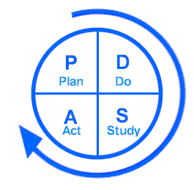
Improvement Models
Walter A. Shewhart
W. Edwards Deming
Act
Plan
Check
Do
Notes:
Shewhart, who developed the concepts and techniques of Statistical Process Control, was one of the first quality experts to discuss a systematic model for CQI. The model discussed in his book is what is widely known today as the PDCA model. After Deming went to Japan as part of the Allied occupation after WWII to teach Japanese industrial quality improvement methods, Deming modified Shewhart’s original model and renamed it the PDSA cycle. PDSA is the most widely recognized improvement process today. To ensure CQI, the steps perpetually cycle and repeat.
Plan
State the objectives of the improvement project
Determine the needed improvements
Design process changes to achieve the improvement objectives
Develop a plan to carry out the changes
Identify data that need to be collected to determine whether changes produced desired results.
Do
Implement changes on a small scale
Document problems and unexpected events
Gather data to assess the changes’ impact on the process
Study
Analyze data to determine whether the changes were effective
Compare results with expectations
Summarize lessons learned during and after implementation of the changes
Act
If changes were not successful, repeat PDSA
If changes were successful, or partially successful, implement them on a wider scale or modify them as necessary
Predict results

Slide 6
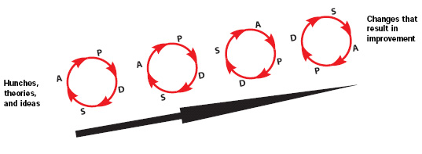
Improvement Models
Rapid Cycle Improvement
Notes:
PDSA is used in rapid cycle improvement projects. Unlike a comprehensive, and often time consuming process, RCI incorporates several small process changes and careful measurement of those changes to achieve an improvement goal. This approach is an accelerated method and lasts usually less than 6 weeks per cycle. The approach of collecting and analyzing data and making changes on the basis of that analysis has a quick turnaround between improvement cycles.

Slide 7
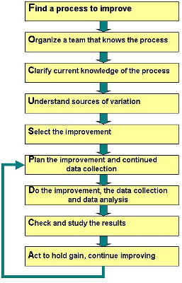
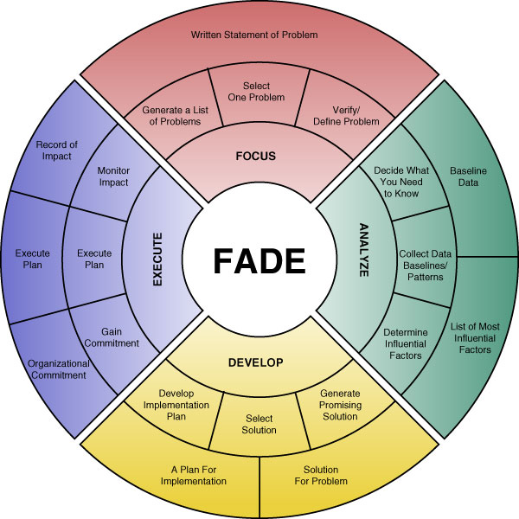
Improvement Models
FOCUS-PDCA
FADE
Notes:
FOCUS-PDCA was created by Nashville TN based HCA in the 1990s. This expanded the PDCA method by adding a preliminary step known as FOCUS. The FOCUS steps provide a guideline for in depth planning and identification of the problem at hand prior to beginning the improvement process. In this method, FOCUS is:
Find a process that needs improvement. Define the beginning and end of the process, and determine who will benefit from the improvement
Organize a team of people knowledgeable about the process. This team should include employees from various levels of the organization
Clarify the current process and the changes needed to achieve the improvement
Understand the causes of variation by measuring performance at various steps in the process
Select actions needed to improve the process
FADE is an adaptation of the original PDSA process. Developed by Organization Dynamics INC in 2006, this model was created to help create a process to help their consulting firm better help organizations improve quality and productivity and enhance customer service. FADE stands for:
Focus: Choose a problem and write a statement to describe it
Analyze: Learn more about the problem by gathering performance data
Develop: Develop a solution for the problem and plan for implementing the solution
Execute: Implement the plan and monitor results.
FADE works great for all types of performance problems.

Slide 8
Improvement Models: Lean
Lean: Eliminate inefficiencies adversely affecting performance.
Lean’s project goal is to minimize waste.
Notes:
Lean is a specific type of performance improvement tool used to eliminate and reduce inefficiencies, or waste, in processes. A lead process includes only value-added steps and therefore produces little waste. This model was based on the Japanese manufacturing principles used in the Toyota Production System. In healthcare Lean is often used to improve efficiency and reduce errors.
The 5 Lean Principles are:
Value: Identify what is important to the customer and focus on it
Value stream: Ensure all activities are necessary and add value
Flow: Strive for continuous processing through the value stream
Pull: Drive production with demand
Perfection: Prevent defects and re-work

Slide 9
Types of Waste (Muda)
Movement
Waiting
Overprocessing
Defects
Inventories
Transportation
Design
Overproduction

Slide 10
Lean Project Steps
Performance problem identified
Evaluate current work processes
Identify areas of opportunity
Find root causes of problems
Design better way of working
Create implementation plan
Identify expected improvements
Make process changes and measure results
Notes:
Kaizen event: A focused, short term project aimed at improving a particular process
5

Slide 11
5 S’ of Lean
Sort
Straighten
Scrub
Standardize
Sustain

Slide 12
Improvement Models: Six Sigma
Six Sigma: Reduce performance variability
Goal: Create processes that operate within Six Sigma quality.
The higher the sigma level, the lower the defect rate.
1 sigma = 32% defect rate
2 sigma = 5% defect rate
6 sigma = 99.999% defect rate (near perfect)
Notes:
Six Sigma is a systematic, data driven improvement approach whose goal is the near-elimination of defects from every product, process, and transaction. Six Sigma originated in the manufacturing sector at Motorola and was refined by GE.

Slide 13
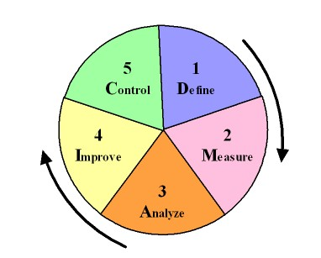
Six Sigma Project Steps
Notes:
DMAIC Methodology of Six Sigma
Define the problem
Measure key aspects of the process
Analyze the data
Improve the system
Control and sustain the improvement

Slide 14
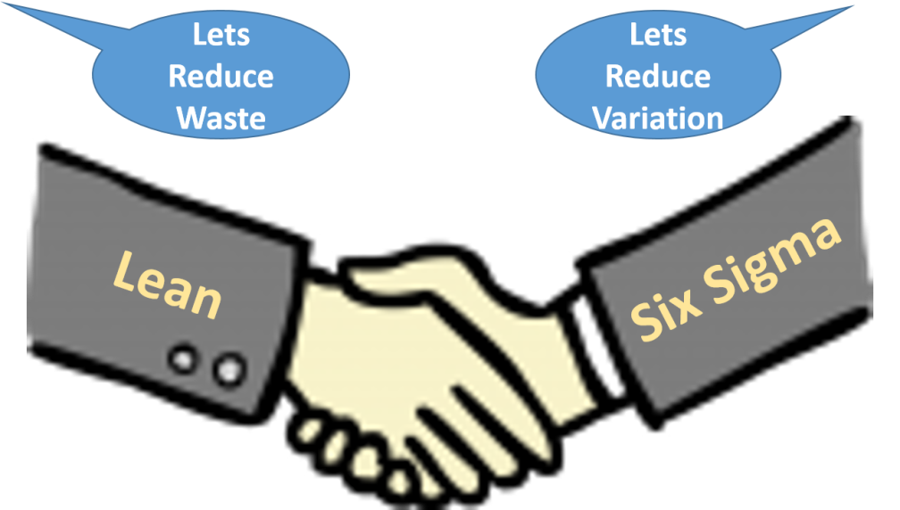
Improvement Models: Lean Six Sigma
Lean Six Sigma: Eliminate waste and reduce process variation
Notes:
Although common improvement models are presented separately in the chapter, the models are not mutually exclusive. Organizations may combine elements of different models to achieve improvement goals. Lean Six Sigma is a popular process that combines the techniques of Lean and Six Sigma to maximize improvement results and provide a comprehensive approach to quality improvement.

